Slide 1

Unified Ensemble Learning for Cyber Attack Detection and Classification in Wireless Sensor Networks
by
Lakshmi Moksha B
Roll No. 224G1A3246
Dinesh Reddy C
Roll No. 224G1A3218
Karthik P
Roll No. 224G1A3239
Akash R
Roll No. 224G1A3206
Under the guidance of
Dr. P. Chitralingappa _{M. Tech., Ph.D.}
Associate Professor & HOD
Department of Computer Science and Engineering (Data Science)
Srinivasa Ramanujan Institute of Technology
(Affiliated to JNTUA & Approved by AICTE) (Accredited by NAAC with ‘A’ Grade & Accredited by NBA (EEE, ECE & CSE)
Rotarypuram Village, B K Samudram Mandal, Ananthapuramu – 515701.
2025 - 2026

Slide 2
Abstract
Cyber security plays a vital role in protecting Wireless Sensor Networks (WSNs), which are widely used in industrial monitoring, environmental sensing, and smart applications. Due to wireless communication and limited computational resources, WSNs are highly vulnerable to various cyber-attacks. Many existing security solutions mainly focus on detecting attacks and fail to accurately classify different attack types. This project proposes an ensemble-based cyber attack detection and classification system using machine learning and deep learning models such as Stacking, XGBoost, AdaBoost, MLP, and Autoencoder. The system analyzes network behavior using the WSN-DS dataset to detect and classify cyber-attacks effectively. Simulation is performed using the COOJA simulator to analyze node communication behavior and validate the system performance. The proposed system improves detection accuracy, reliability, and security of Wireless Sensor Networks.

Slide 3


Contents
Introduction
Literature Survey
Existing System
Proposed System
Objectives of Project
Planning and Design
Requirements
Modules
UML Diagrams
Data Flow Diagram
Screenshots (Project Output)
References
Conclusion
Paper Submission Proof

Slide 4
Introduction
Cyber security is important for protecting networks, communication systems, and data from cyber-attacks and unauthorized access.
Wireless Sensor Networks (WSNs) consist of sensor nodes that collect and transmit data wirelessly to a base station.
WSNs are widely used in industrial monitoring, environmental monitoring, healthcare, military applications, and smart city systems.
Due to wireless communication and limited battery, memory, and processing power, WSNs are highly vulnerable to cyber-attacks.
Attacks such as Flooding, Blackhole, Grayhole, and TDMA scheduling attacks can disrupt network communication and affect data reliability.
Machine learning, deep learning, and ensemble learning techniques help in detecting and classifying cyber-attacks by analyzing network behavior.

Slide 5
Literature Survey
Unified Ensemble Learning for Cyber Attack Detection and Classification in Wireless Sensor Networks
Detecting Cyber Attacks In WSNs using Ensemble Techniques
No | Title | Author | Journal Name & Year | Methodology Adapted | Key Findings | Gaps
1. | A Situation Based Predictive Approach for Cybersecurity Intrusion Detection and Prevention Using Machine Learning and Deep Learning Algorithms in Wireless Sensor Networks of Industry 4.0 | FATIMA AL-QUAYED , ZULFIQAR AHMAD AND MAMOONAHUMAYUN | I2CT ( IEEE 9th International Conference for Convergence in Technology) 2024 | Decision Tree, MLP, Autoencoder | Effective detection of WSN attacks using single model | Uses only single models at a time, does not combine methods or adapt to evolving attacks
2. | Evaluation of Machine Learning Algorithms for Intrusion Detection System in Wireless Sensor Network | Mousa Tawfiq AL-Akhras , Mohammed Alawairdhi | International Journal of Advanced Computer Science and Applications 2021 | Naive Bayes , Random Forest Algorithm | Analyze and protect WSN networks in combination with firewalls and Deep Packet Inspection | Not suitable for the advanced cyber attacks like Grey hole, Flooding.
A-10

Slide 6
Existing System
Existing cyber security systems for Wireless Sensor Networks mainly use individual machine learning or deep learning models to detect abnormal network behavior.
These systems analyze network parameters like packet transmission, node communication and energy usage to identify possible cyber-attacks.
Many existing approaches mainly focus on detecting the presence of attacks and may not clearly classify different types of cyber-attacks.
Detection performance of single models may vary based on attack type and network conditions.
Individual models may not effectively handle complex and diverse cyber attack patterns.
Most existing systems focus only on detection and do not provide proper prevention or mitigation methods after attack detection.

Slide 7
Proposed System
The proposed system is designed to detect, classify, and prevent cyber-attacks in Wireless Sensor Networks using advanced learning techniques.
The system uses ensemble and deep learning models such as Stacking, XGBoost, AdaBoost, MLP, and Autoencoder for better detection performance.
The system can detect and classify multiple cyber-attacks such as Flooding, Blackhole, Grayhole, and TDMA scheduling attacks.
Ensemble learning improves detection accuracy and helps handle complex and diverse attack patterns compared to single models.
The system analyzes network behavior using the WSN-DS dataset for training and testing.
The system also provides prevention and mitigation suggestions after detecting cyber-attacks and is validated using COOJA simulation.

Slide 8
Objectives of Project
To detect cyber-attacks in Wireless Sensor Networks using machine learning techniques.
To classify different types of cyber-attacks such as Flooding, Blackhole, Grayhole, and TDMA attacks.
To improve detection accuracy using ensemble and deep learning models.
To analyze network behavior using the WSN-DS dataset.
To validate system performance using COOJA simulation

Slide 9
Requirements
Functional Requirements:
The system should allow users to upload WSN network dataset files for analysis.
The system should allow selection of different machine learning models for cyber attack detection.
The system should detect cyber-attacks based on network traffic data.
The system should classify detected cyber-attacks into specific attack types.
The system should provide prevention and mitigation suggestions after attack detection.
The system should display prediction results and forensic analysis information to the user.

Slide 10
Requirements
Non-Functional Requirements:
The system should provide high detection accuracy for cyber attack identification.
The system should ensure reliable and consistent performance during analysis.
The system should provide fast processing and response time for prediction results.
The system should ensure data security and safe handling of uploaded datasets.
The system should provide a user-friendly interface for easy interaction.
The system should be scalable to handle large WSN datasets and multiple users.

Slide 11
Modules
User Modules:
Registration & Login: Users can register and log in securely to access the system.
Dataset Upload: Users can upload WSN network dataset files for cyber attack analysis.
Model Selection & Prediction:Users can select machine learning models and perform cyber attack detection.
Attack DetectionResults:Users can view detected attack type, severity level, and analysis results.
Prevention & Forensic Report: Users can view prevention methods and forensic analysis details.
System Modules:
Attack Detection Module: Uses machine learning, deep learning, and ensemble models to detect cyber attacks.
Attack Classification Module: Classifies detected attacks into specific cyber attack types.
Prevention Suggestion Module: Generates prevention and mitigation methods for detected attacks.
Forensic Logging Module: Stores attack details, severity level, and mitigation data for analysis.
Result Visualization Module : Displays attack results, severity levels, and analysis reports in a user-friendly format.

Slide 12
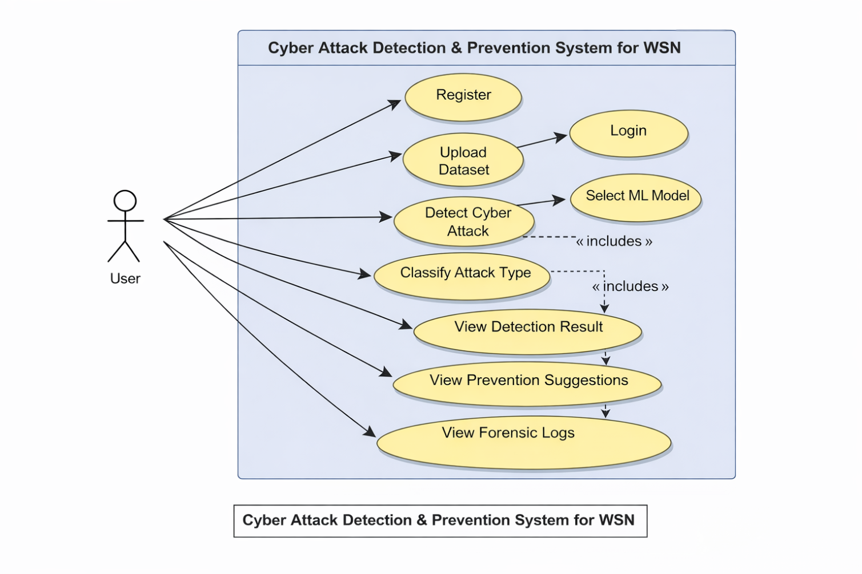
UML Diagrams
Use Case Diagram:
The UML Use Case Diagram shows the interaction between the user and the cyber attack detection and prevention system..
The user can register, log in, upload WSN dataset, and select machine learning models for attack detection.
The system detects and classifies cyberattacks and provides prevention suggestions.
The system also stores attack details in forensic logs for monitoring and analysis.

Slide 13
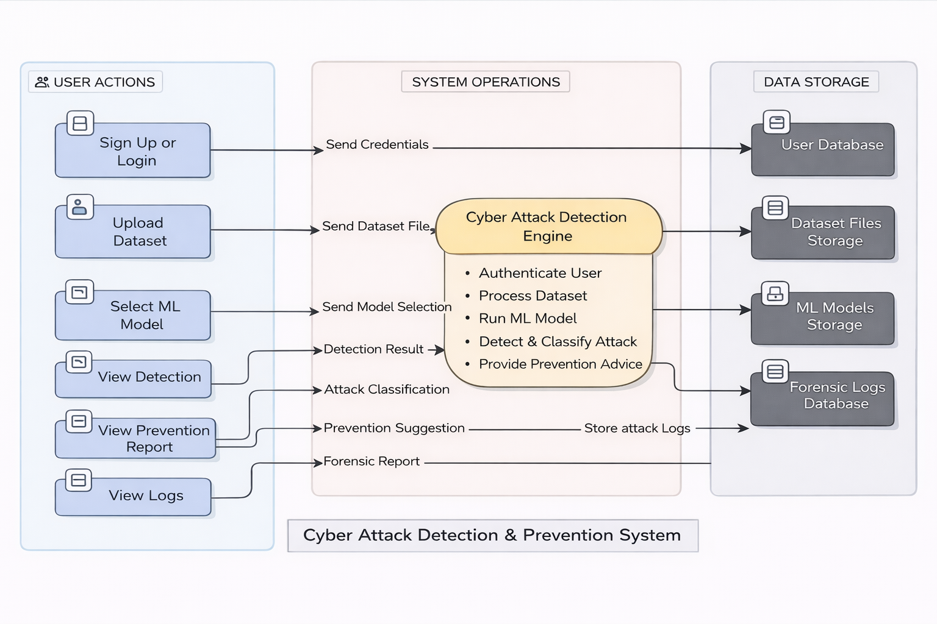
Data Flow Diagram

Slide 14
Data Flow Diagram
The diagram shows how data flows between the user, system processing unit, and data storage components..
The user performs actions such as login, dataset upload, and machine learning model selection.
The system processes the uploaded dataset using trained machine learning models to detect cyber attacks.
The system classifies detected attacks and generates prevention suggestions and forensic reports.
Important data such as user information, dataset files, ML models, and forensic logs are stored in separate data storage modules.
The system sends detection results, attack classification details, and prevention suggestions back to the user.

Slide 15
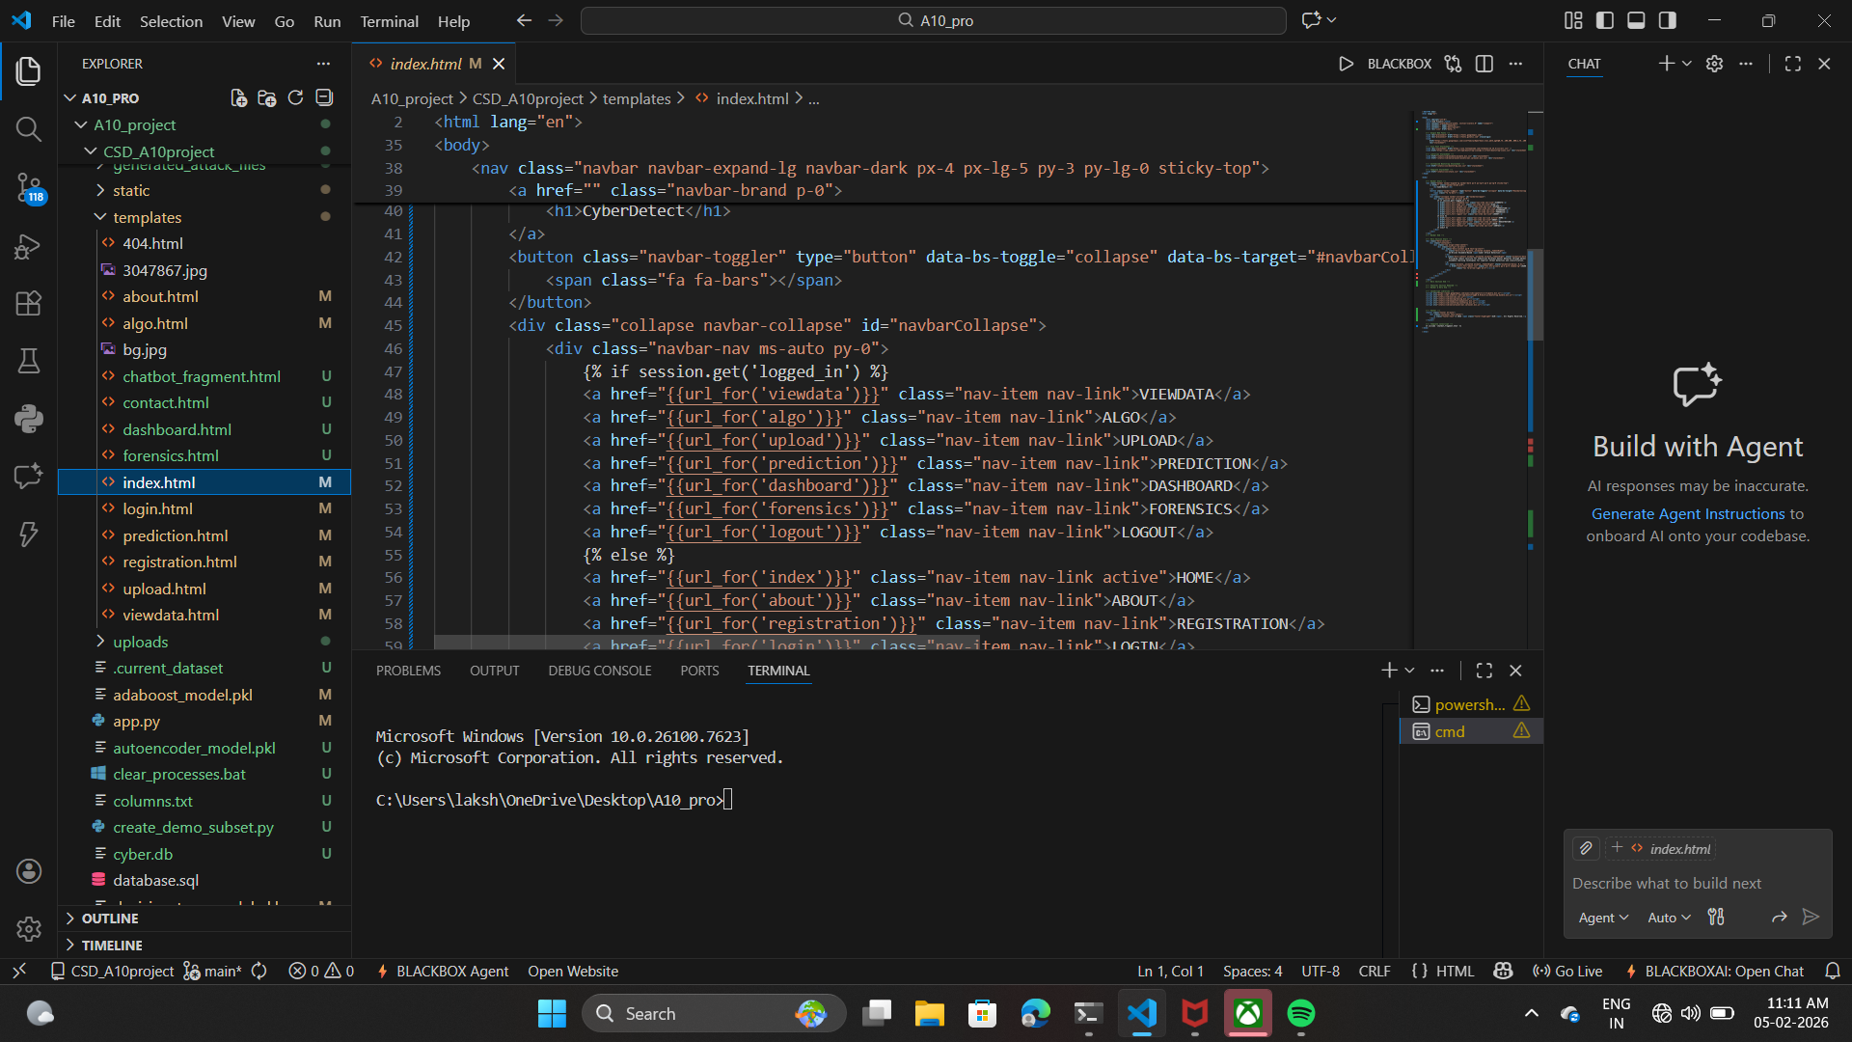
Sample Code

Slide 16
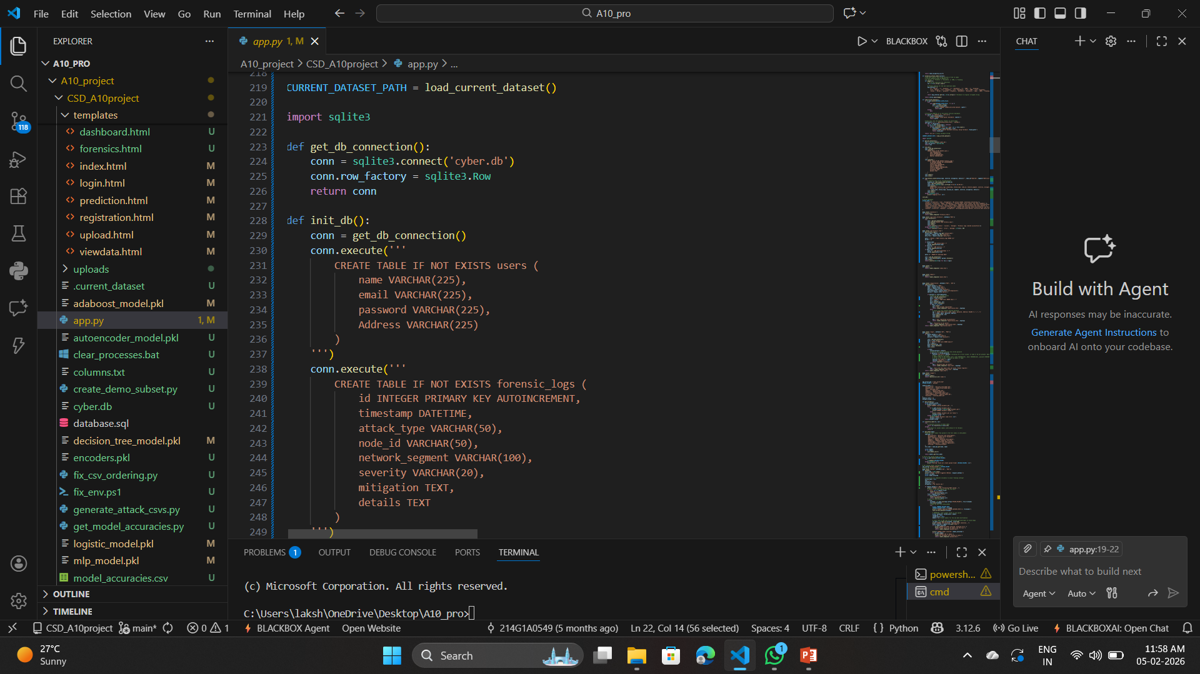
Sample Code

Slide 17
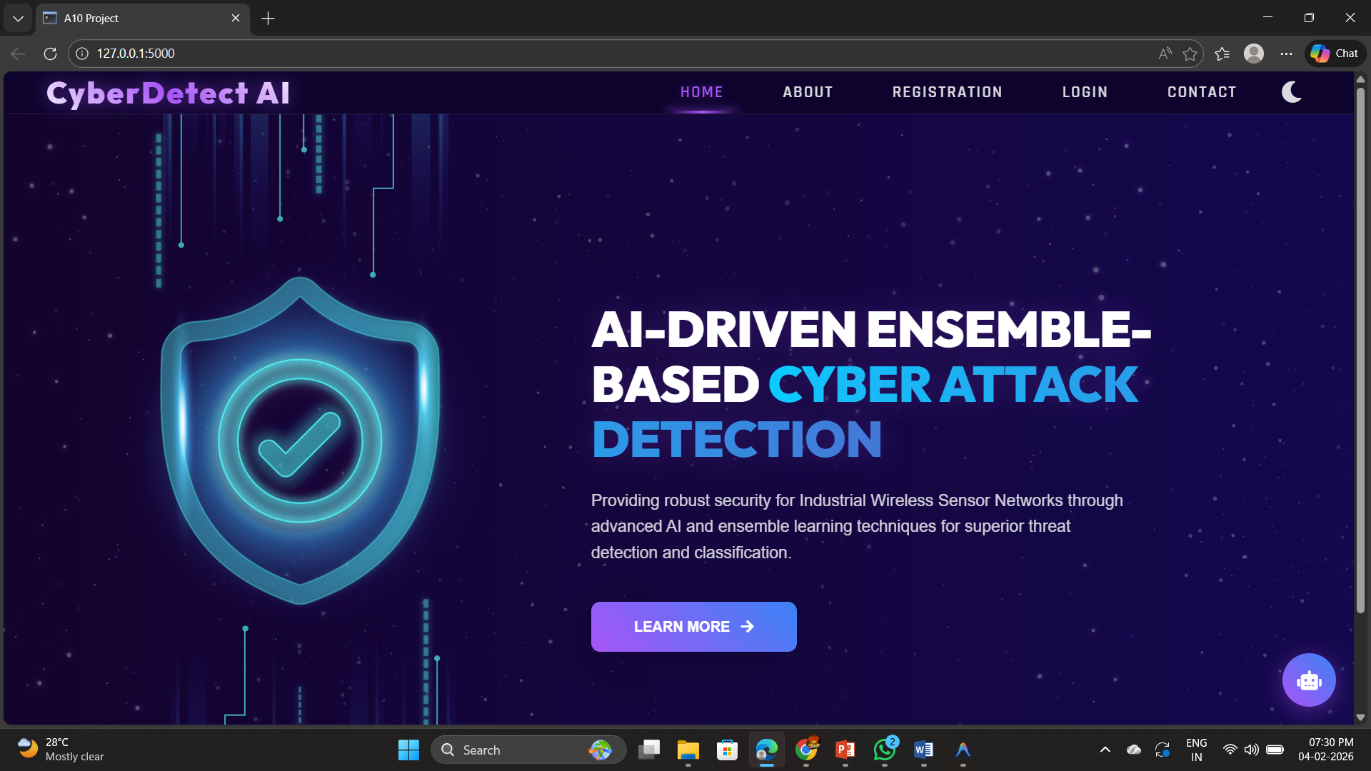
Output Screens
Homepage

Slide 18
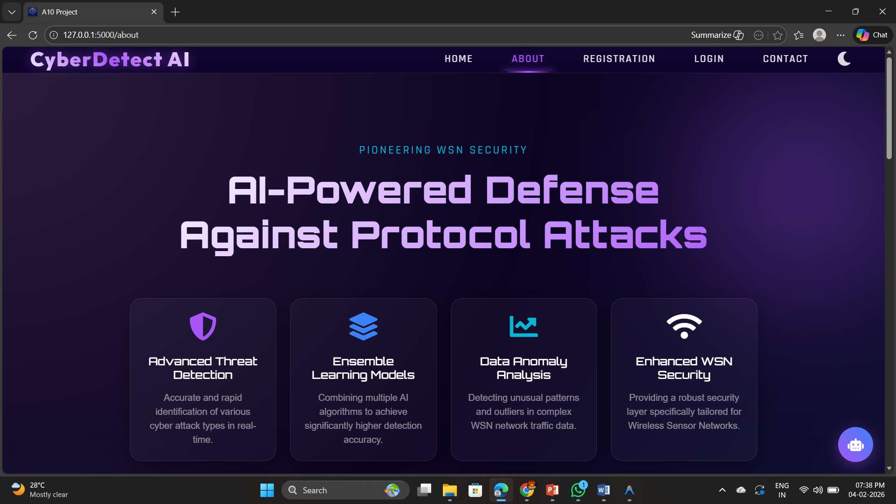
Output Screens
About page

Slide 19
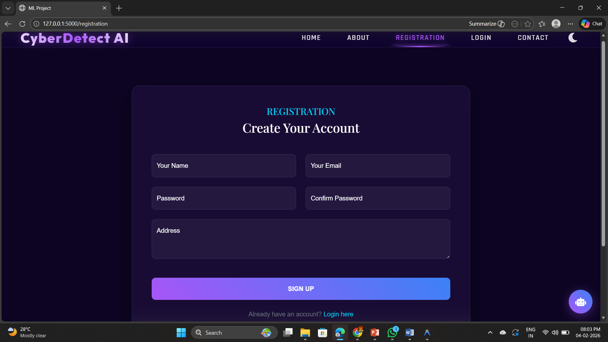
Output Screens
Signup: Create user account by providing the details

Slide 20
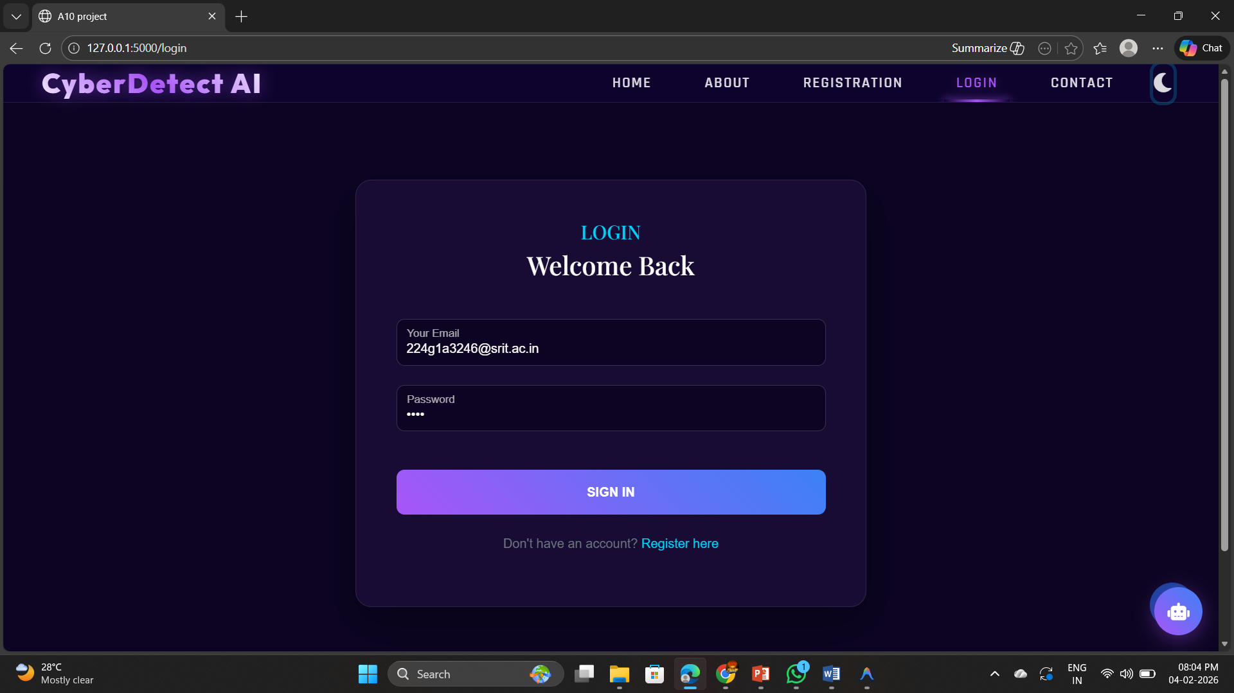
Output Screens
Login page

Slide 21
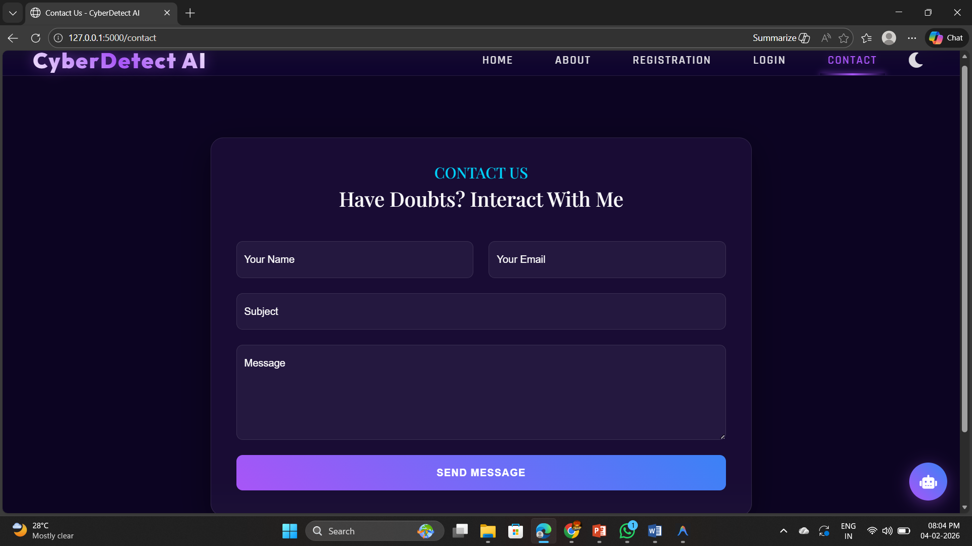
Output Screens
Contact Page

Slide 22
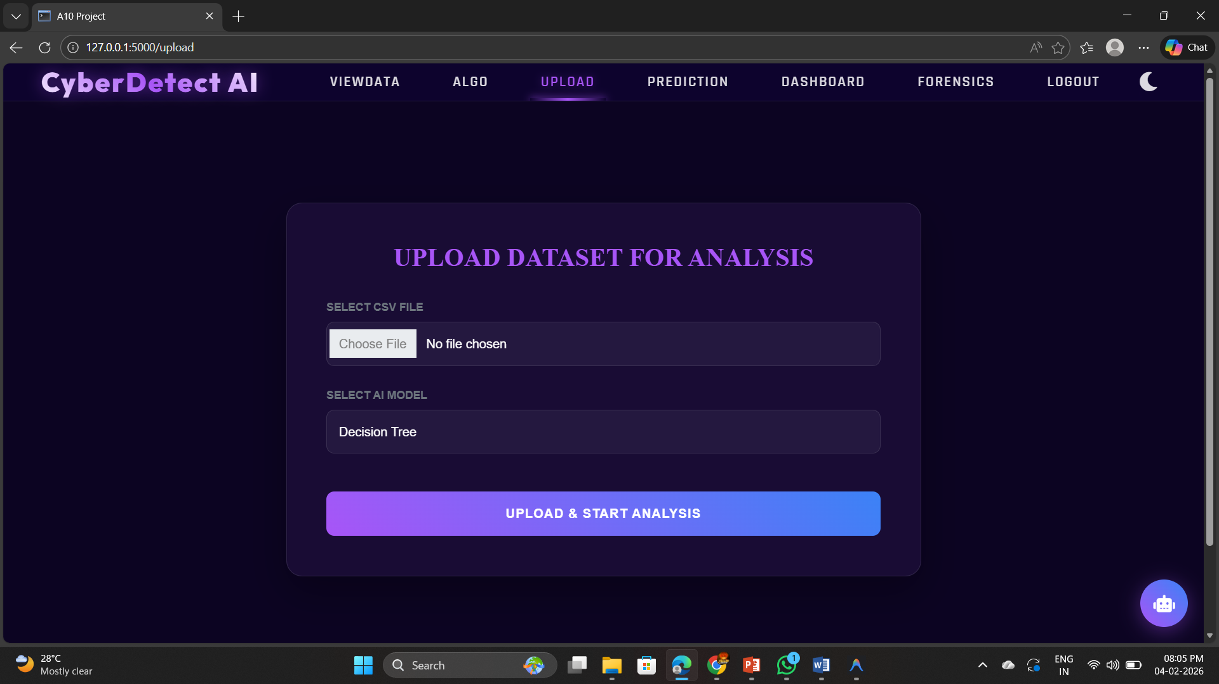
Output Screens
Datasets uploading page

Slide 23
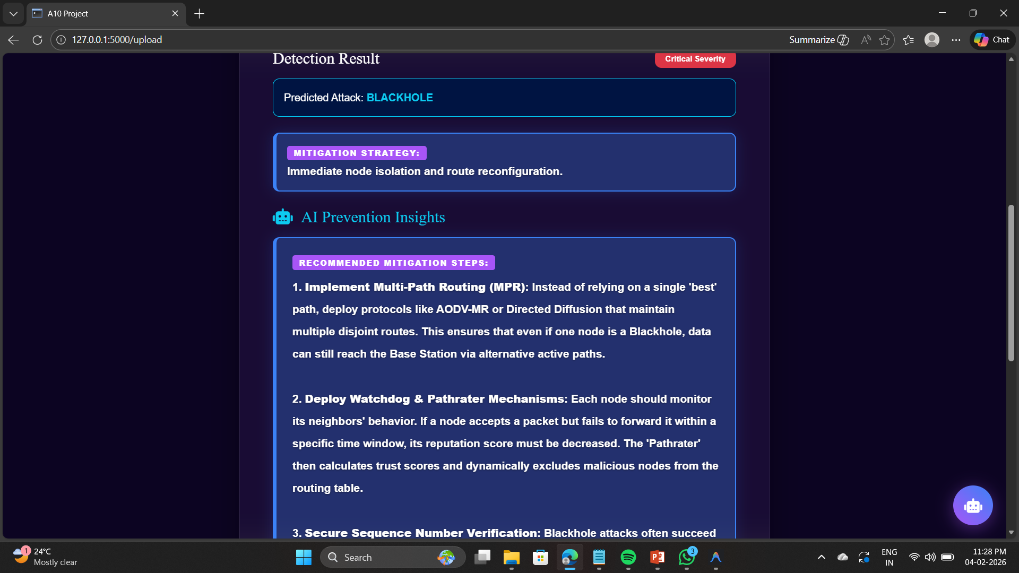
Output Screens
Prevention methods and attack classification

Slide 24
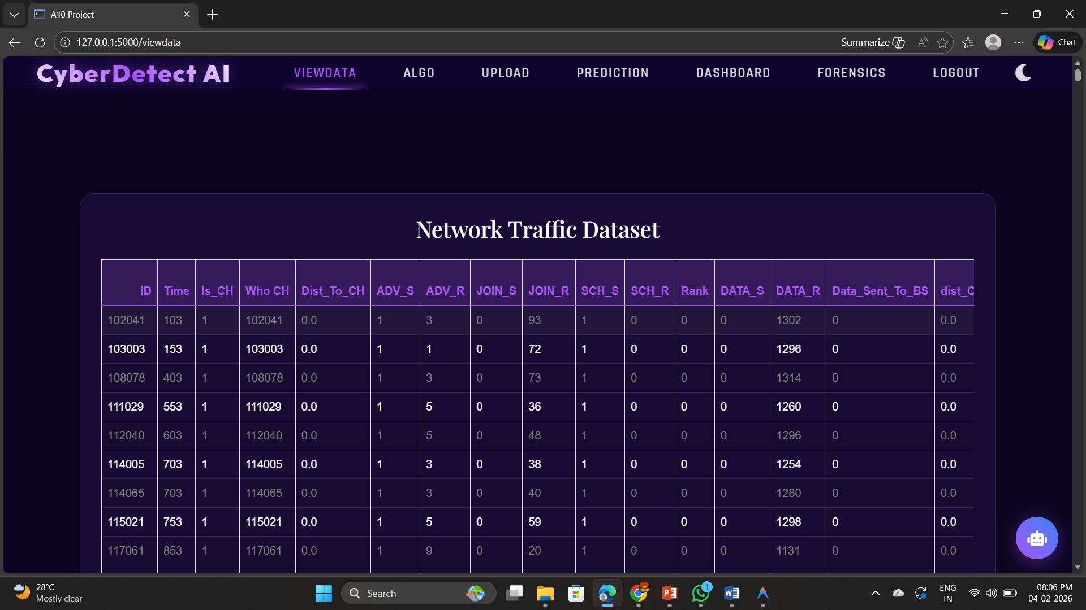
Output Screens
View Data Page

Slide 25
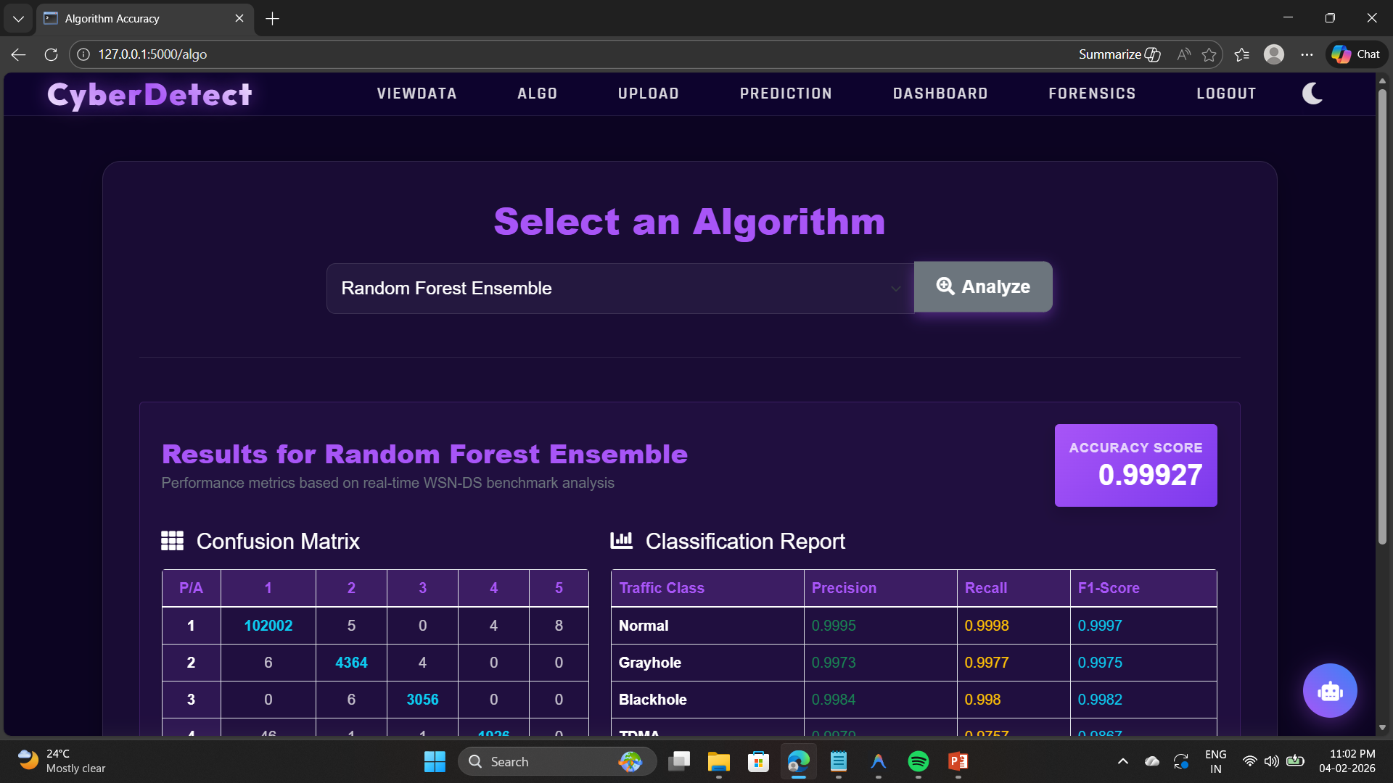
Output Screens
Algorithm Accuracy Page

Slide 26
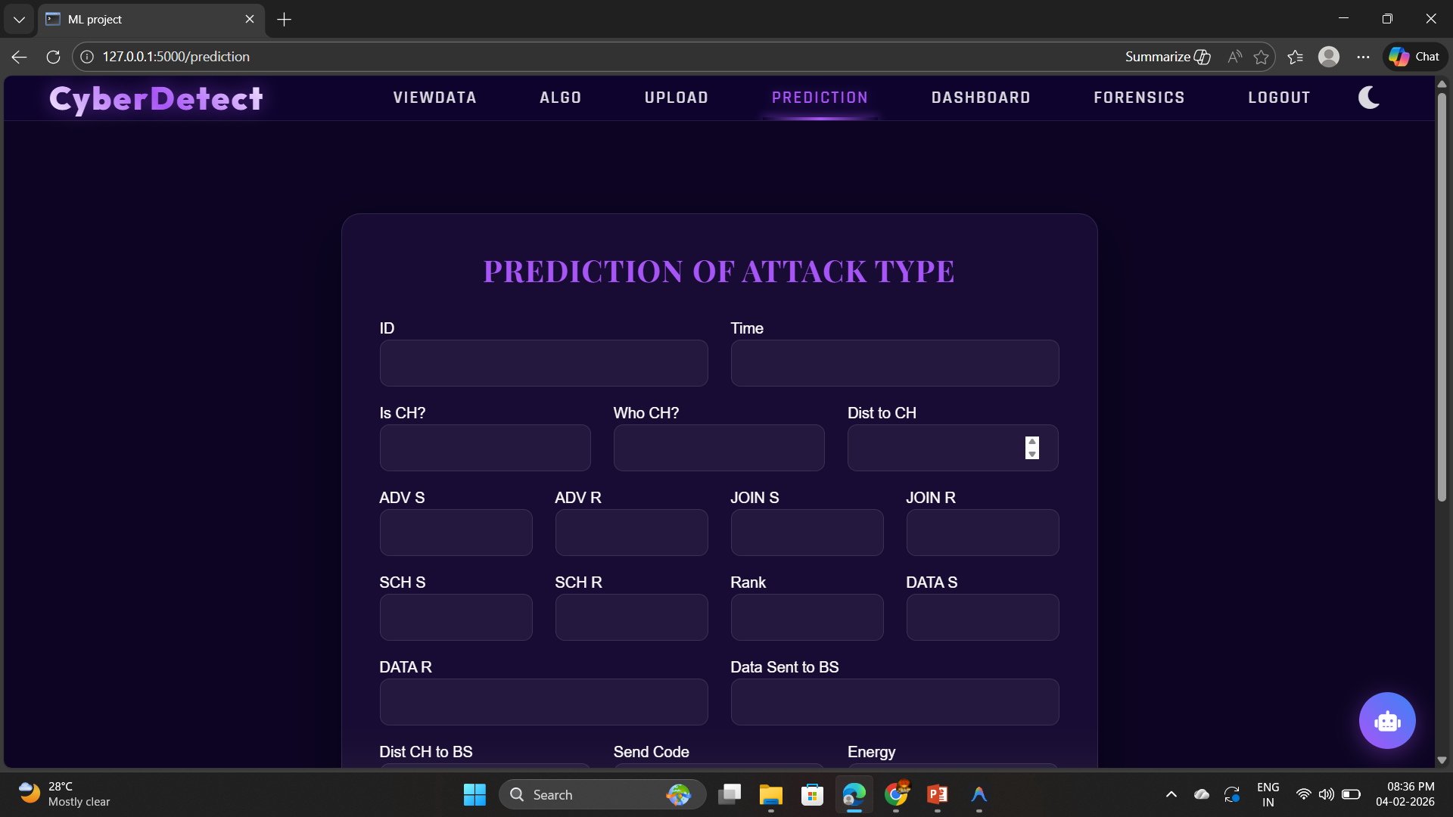
Output Screens
Prediction Page

Slide 27
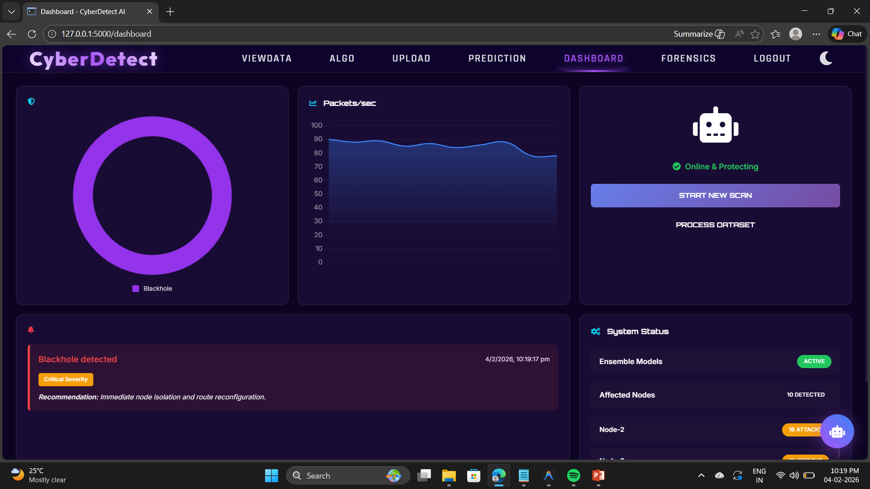
Output Screens
Dashboard

Slide 28
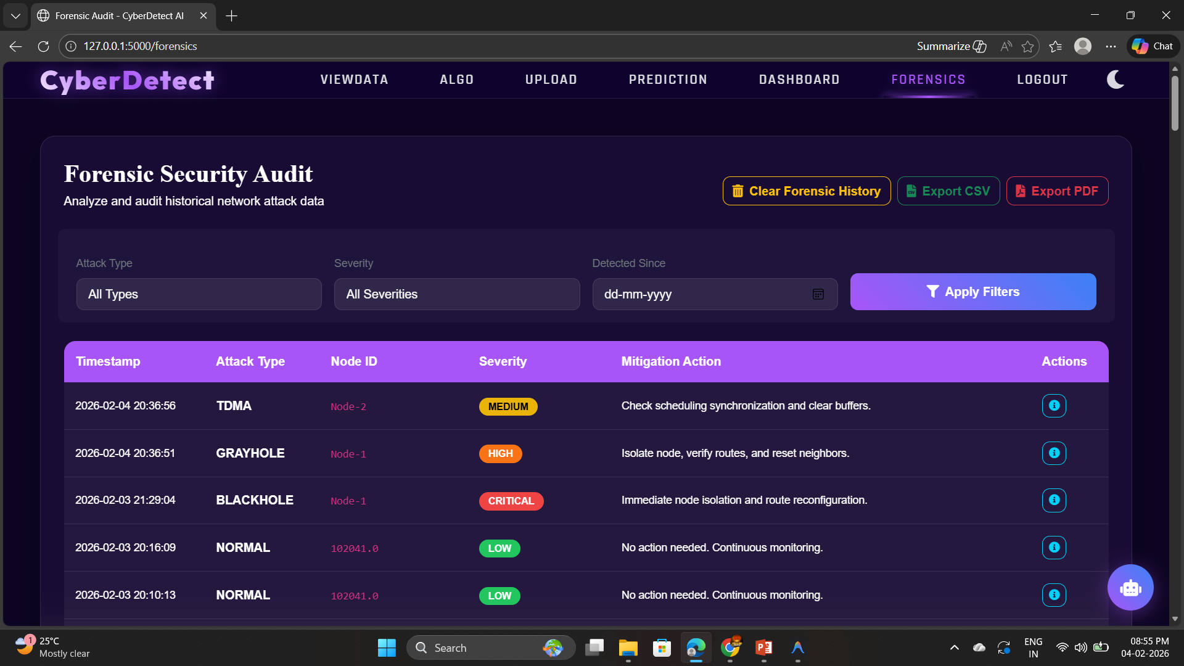
Output Screens
Forensic Report

Slide 29
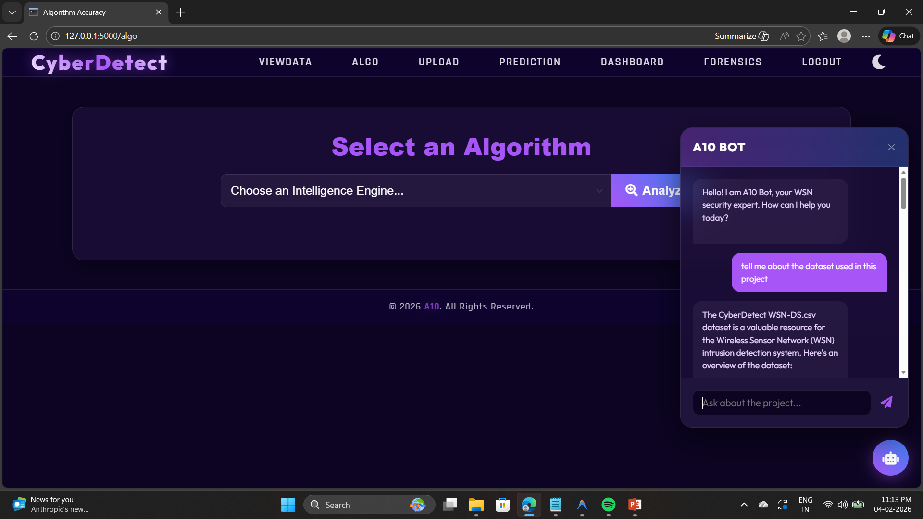
Output Screens
Chatbot

Slide 30
References
[1]. S. Karthikeyan, R. Kumar, and P. Rajesh, “Machine Learning-Based Cyber-Attack Detection in Wireless Sensor Networks,” International Journal of Research in Engineering and Technology, vol. 12, pp. 45–50, 2025.
[2]. M. Al-Akhras, M. Al-Kasasbeh, and I. Almomani, “Evaluation of Machine Learning Algorithms for Intrusion Detection in Wireless Sensor Networks,” International Journal of Advanced Computer Science and Applications, vol. 12, pp. 300–308, 2021.
[3]. A. A. Al-Quayed, M. Al-Hubaishi, and S. A. Khan, “A Situation-Based Predictive Approach for Cybersecurity Intrusion Detection and Prevention Using Machine Learning and Deep Learning Algorithms in Wireless Sensor Networks of Industry 4.0,” IEEE Access, vol. 12, pp. 1–15, 2024.
[4]. R. Hawi, J. Karam, and H. Nassar, “Unveiling the Hidden Threat: How Wireless Networks Fuel Serious Cyber Attacks,” Journal of Information Security and Applications, vol. 78, pp. 1–10, 2024.
[5]. T. Zhukabayeva, A. Buja, and M. Pacolli, “Detecting Network Security Incidents in Wireless Sensor Networks Using Machine Learning,” Indonesian Journal of Electrical Engineering and Computer Science, vol. 37, no. 3, pp. 1650–1660, Mar. 2025.
A-10

Slide 31
Conclusion
In conclusion, the proposed unified ensemble learning based cyberattack detection system for Wireless Sensor Networks has been successfully designed and implemented. The system effectively detects and classifies different types of cyberattacks such as Blackhole, Grayhole, Flooding, and TDMA attacks using a combination of machine learning and deep learning models (Unified Ensemble Model) with 99.88% accuracy.
The integration of multiple models in the form of a unified ensemble improves detection accuracy, classification stability, and overall system reliability. The system also supports anomaly detection to identify unknown or emerging attacks, making it more robust in dynamic network environments.
The implementation includes features such as real-time attack detection, dashboard visualization, forensic logging, PDF and CSV report generation, and an AI chatbot for user assistance. These features enhance the usability and practical applicability of the system.
A-10

Slide 32
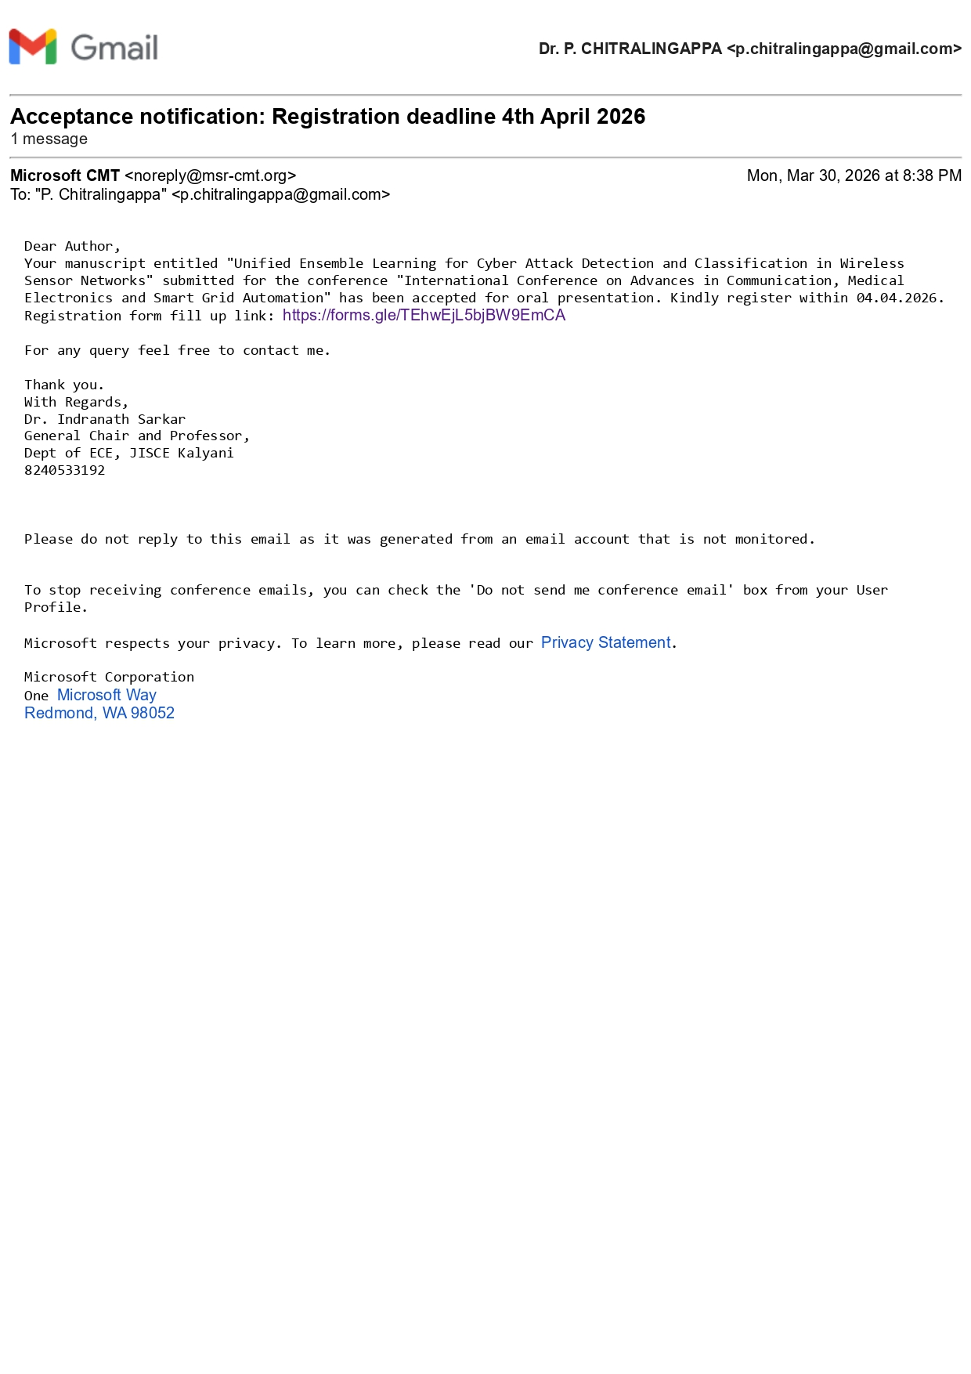
Paper Submission Proof
A-10

Slide 33
Thank You!!!

